Slide 1
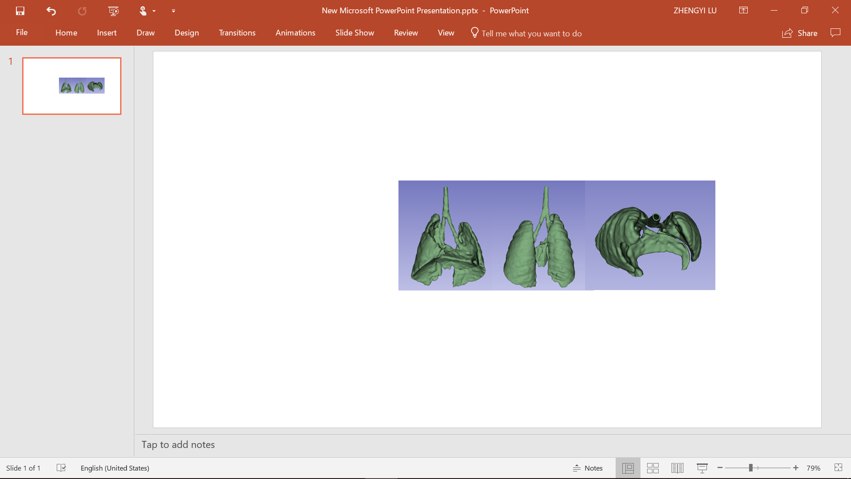
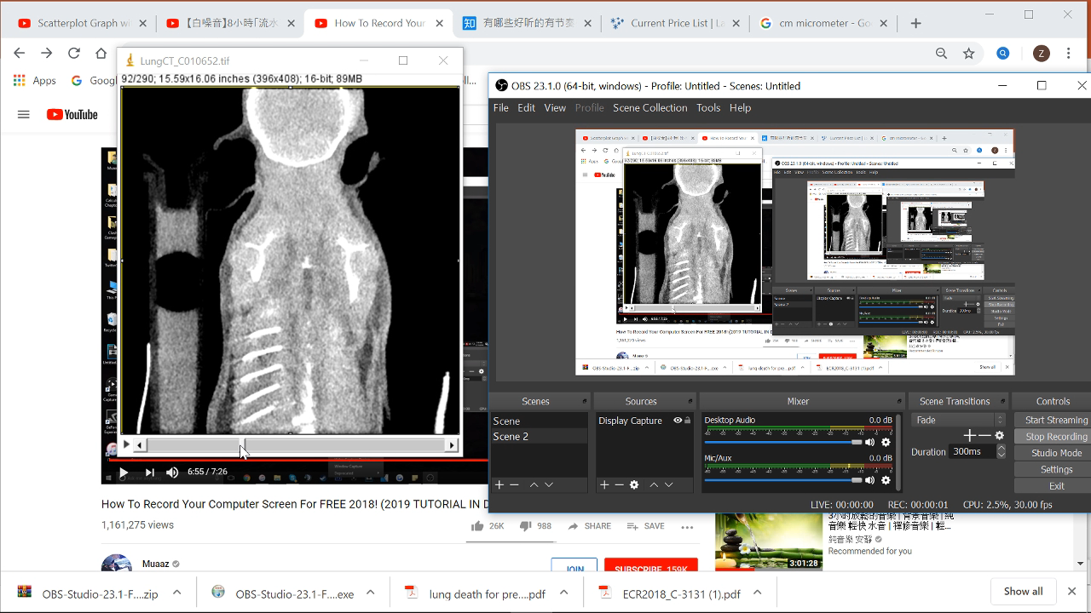
Phantom Production Sequence
3D slicer
Meshmixer
Inventor
Preform
Phantom
Micro-CT images
Threshold based lung segmentation
Left and right lungs separation
Smoothing
Hollowing

Slide 2
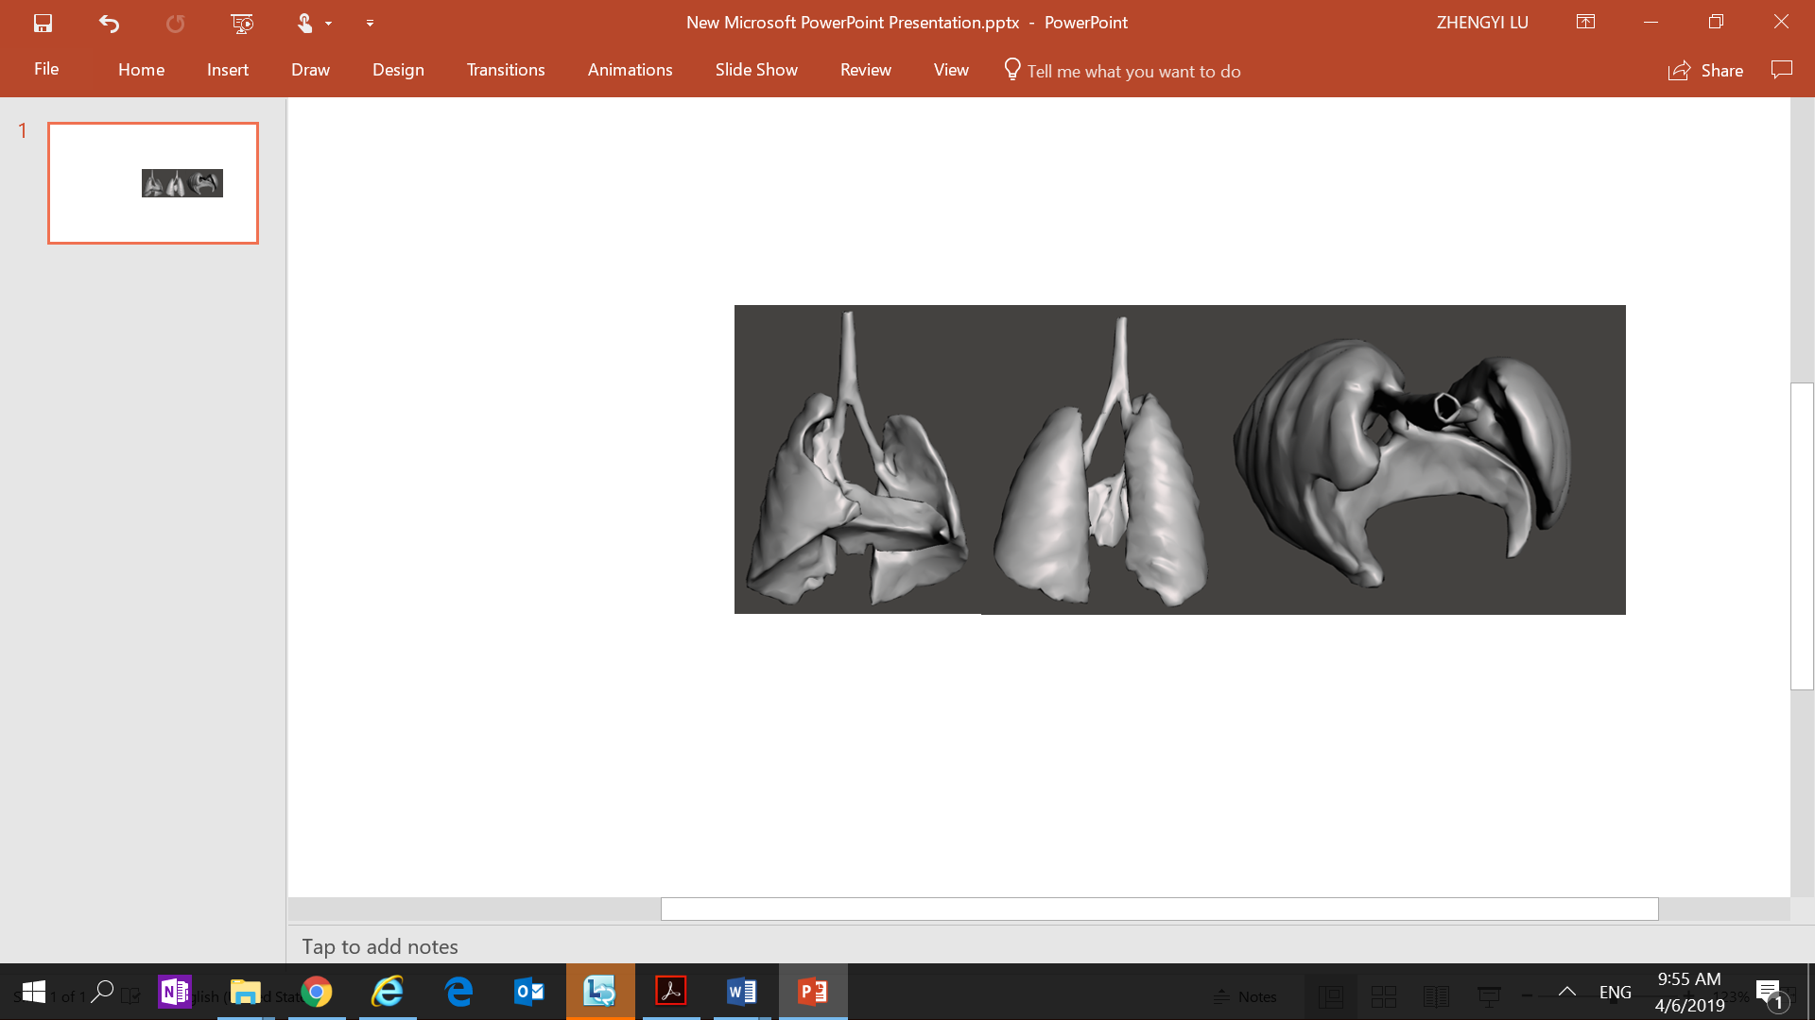
Phantom Production Sequence
3D slicer
Meshmixer
Inventor
Preform
Phantom
Micro-CT images
Resolution reduced to fit downstream software

Slide 3
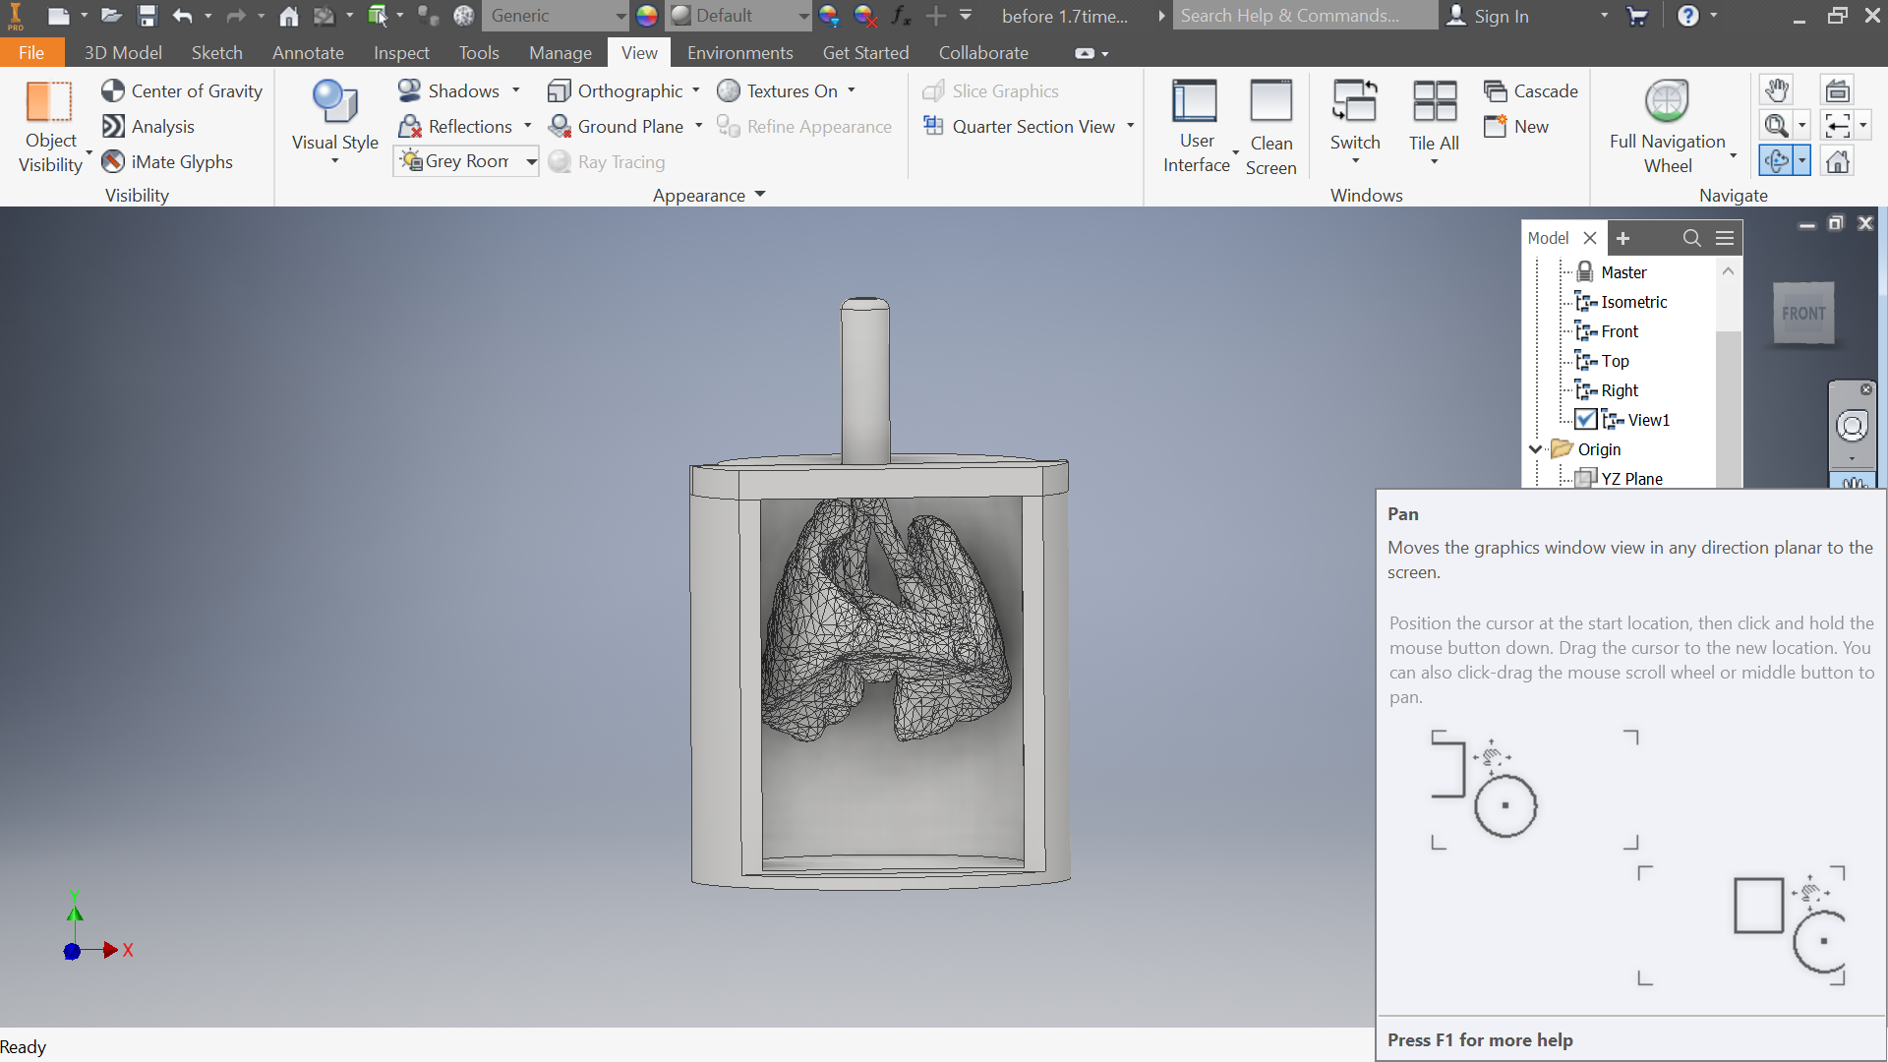
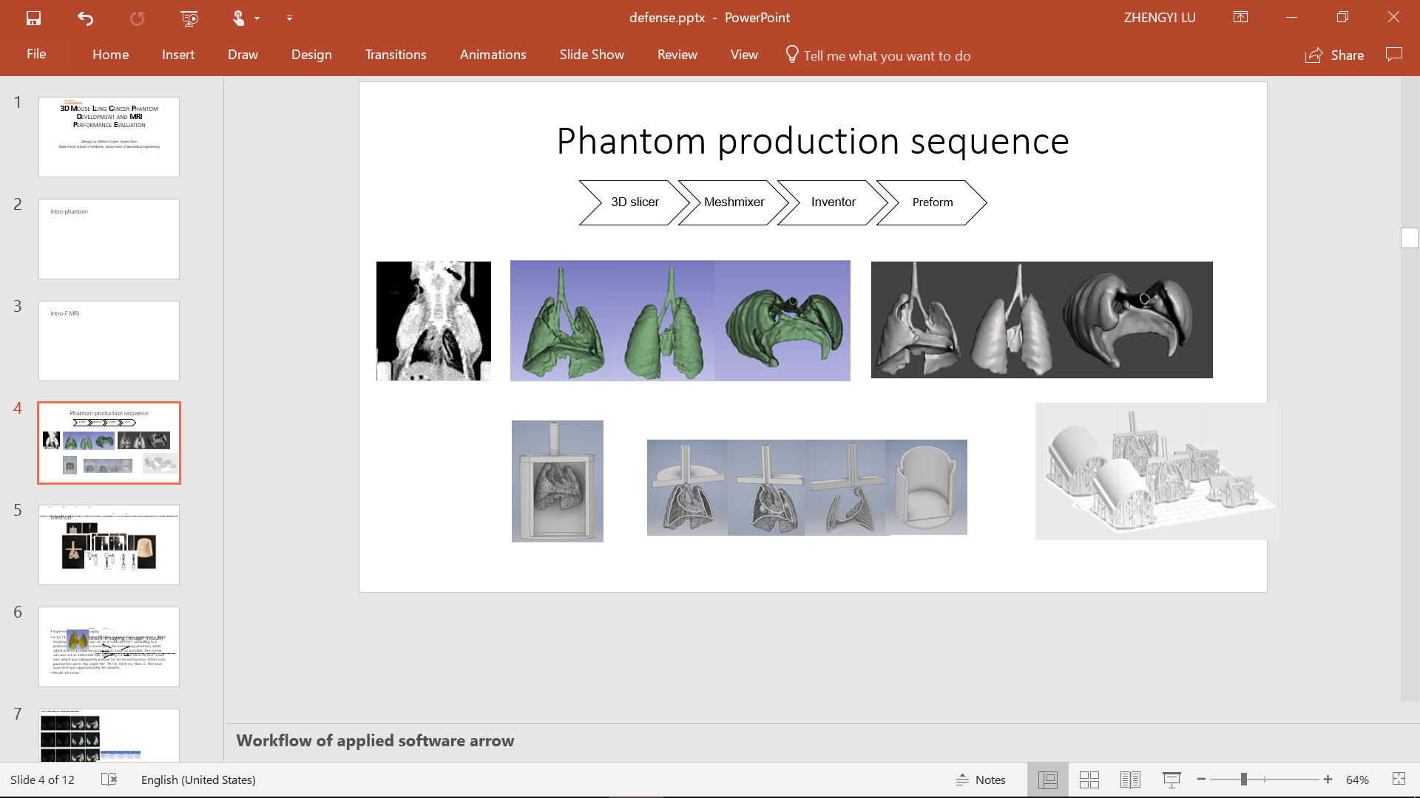
Phantom Production Sequence
3D slicer
Meshmixer
Inventor
Preform
Phantom
Micro-CT images
Mesh to solid
Case, tube, and spheres integrated
Split

Slide 4
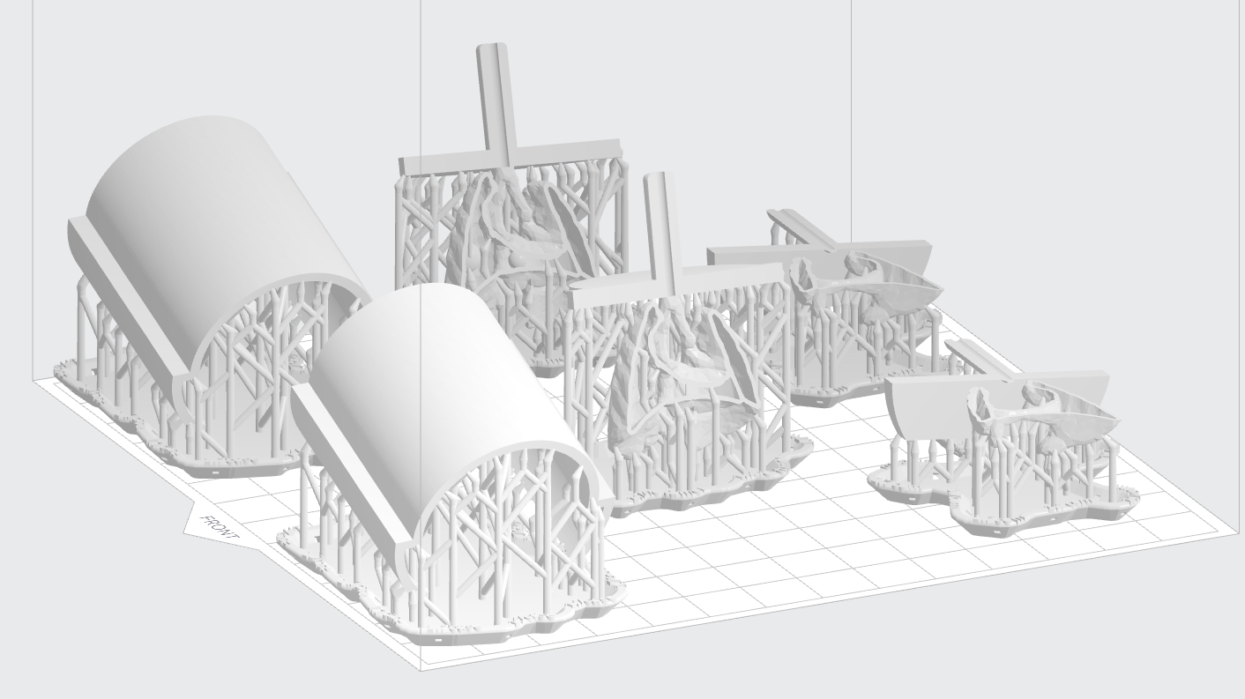
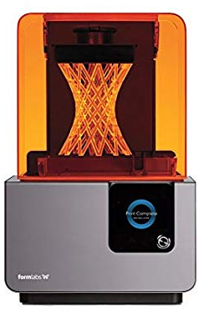
Phantom Production Sequence
3D slicer
Meshmixer
Inventor
Preform
Phantom
Micro-CT images
Formlabs Form 2 SLA 3D Printer
(Amazon.com)

Slide 5
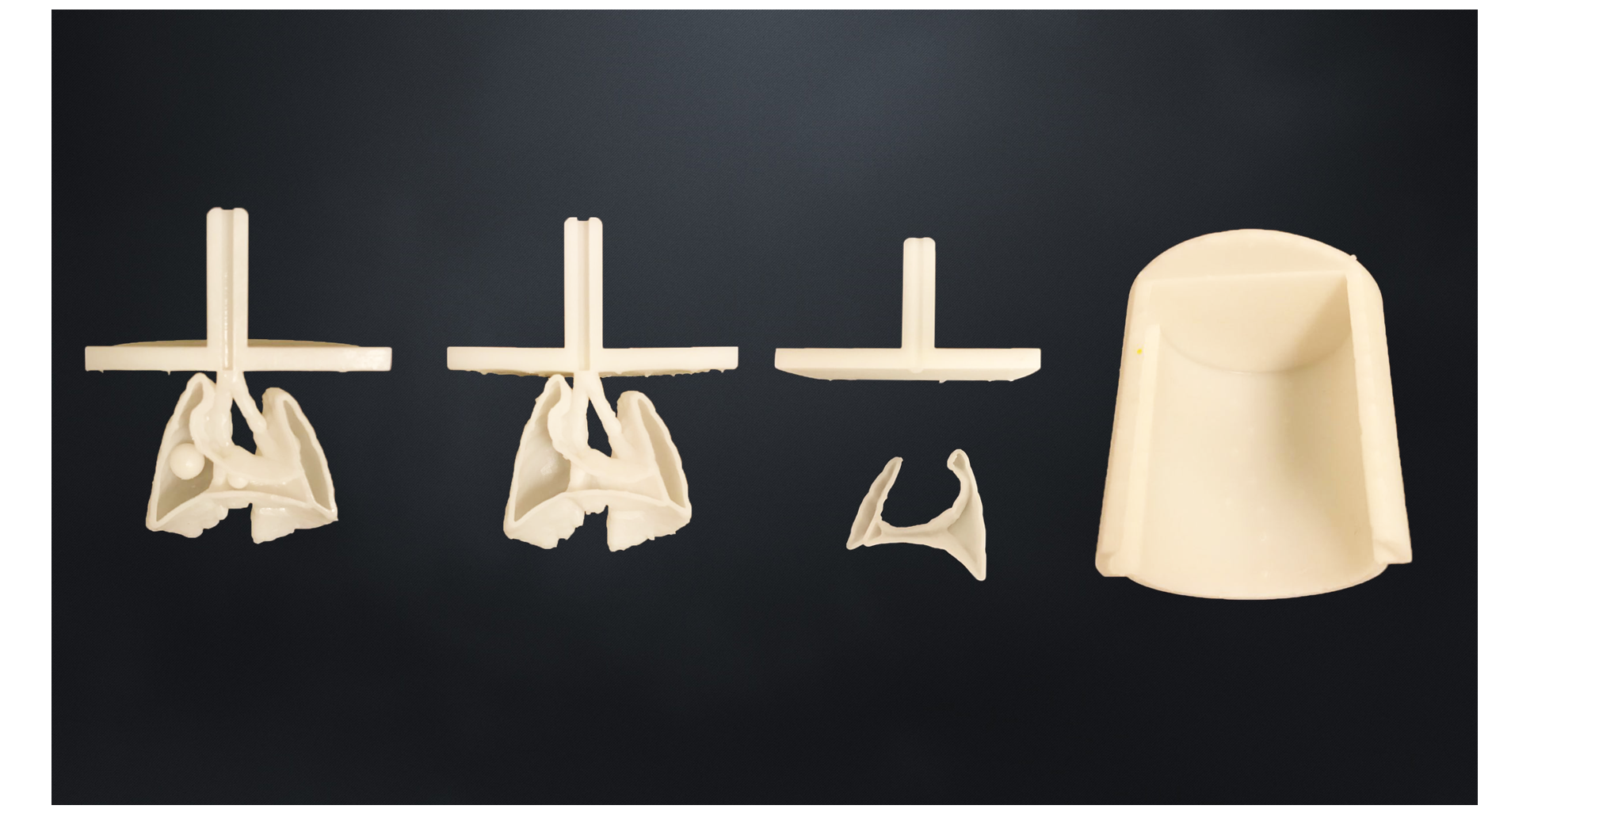
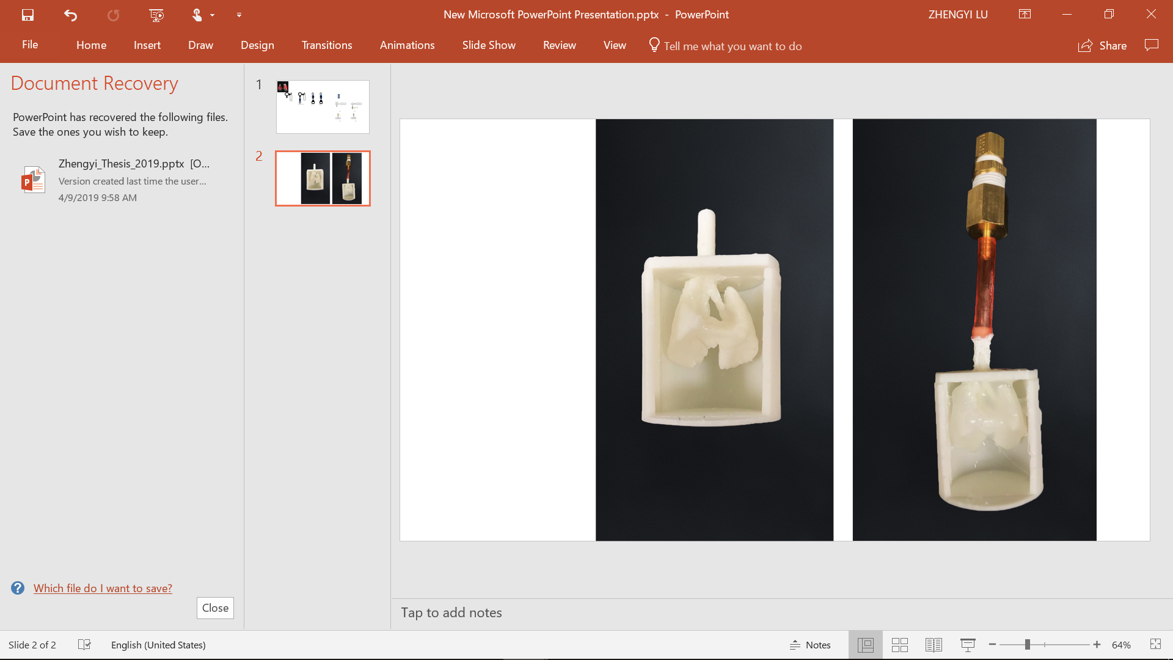
3D Printed Components and Fabricated Phantom
Cancer
Normal

